Slide 1
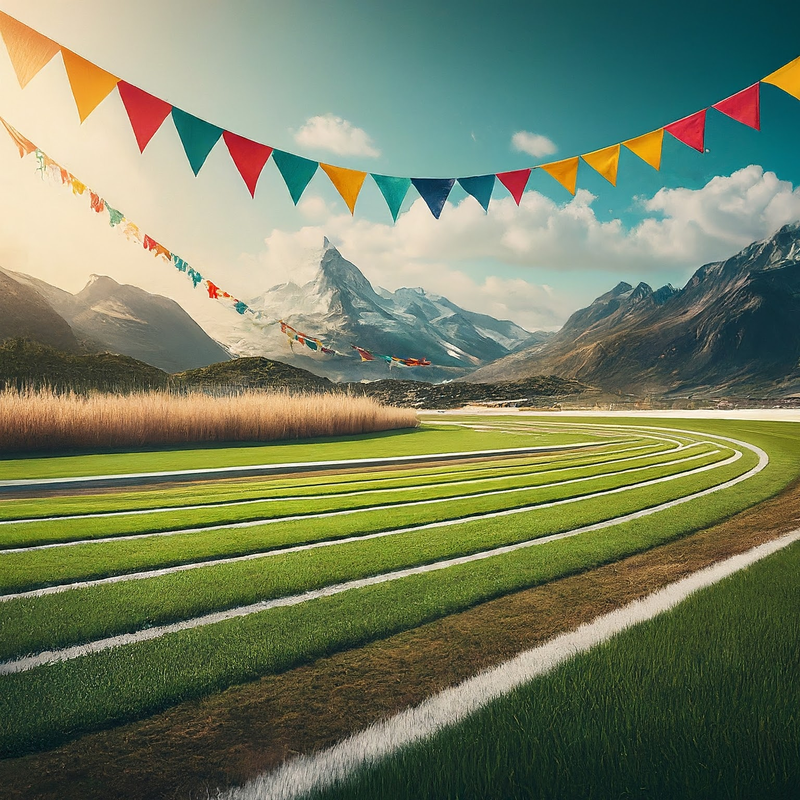
Computer-Science: Mini Project
Project Title: Turtle-Race-Game
Objective of this Project:
To develop a Python game which asks the user to bet on a turtle and score points.

Slide 2
Introduction:
The turtle race project combines elements of programming, graphics, and user interaction to create a fun and interactive game. It’s relevant in the current world in several ways.
Hands-On-Learning: Dive into coding concepts with interactive turtle races. Perfect for beginners to practice loops and conditionals.
Easy-Introduction to Coding: Start coding with visuals! Turtle race project offers a fun way for newcomers to grasp programming basics.
GUI & Visuals Integration: Seamlessly blend GUI with Turtle graphics for interactive user experiences. Learn how to make coding visually engaging.
Creative Problem-Solving: Customize your turtle race game and unleash creativity. Develop problem-solving skills while having fun.
Engaging Gamification: Turn coding into a game! Turtle race project uses gamification to make learning addictive and ejoyable.
Real-World STEM Applications: Explore STEM concepts through a fun turtle race simulation.
Versatile for All Ages: From kids to adults, turtle race projects caters to everyone. Adjust complexity for tailored learning experiences.
Essential Skills for the Digital Era: Equip yourself with coding skills for success in a tech-driven world. Turtle race project fosters creativity, problem-solving and logical thinking

Slide 3
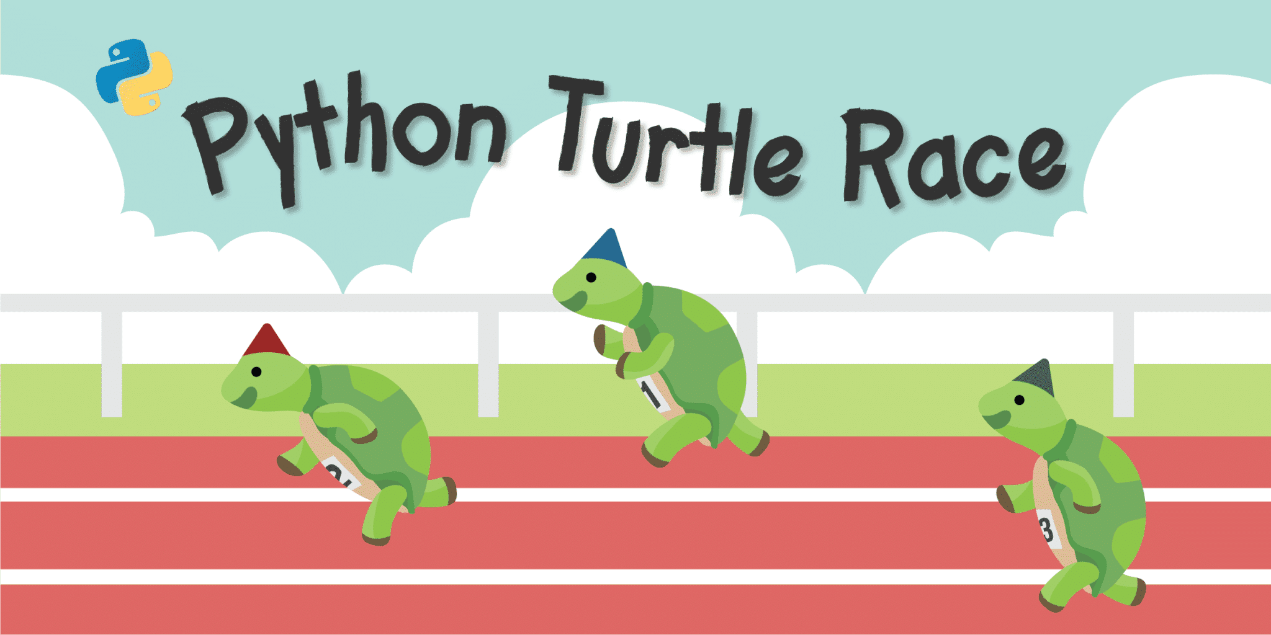
Problem-Statement:
Develop an interactive Python-based Turtle Race Program that employs Turtle graphics and a Tkinter GUI to create an engaging gaming experience where users select a turtle and participate in a thrilling race.

Slide 4
Major Functions:
Start-Race Function:
Initializes the Turtle Race environment using Tkinter.
Positions turtles at the starting line, assigns colors, and controls the race.
Determines the winner and displays results based on user-selected color.
Set Color Functions:
Retrieves user’s chosen turtle color from Tkinter dropdown menu.
Hides Tkinter window and starts race with selected color.
Tkinter Window Setup:
Creates Tkinter window for color selection.
Provides dropdown menu for color selection and ‘Submit’ button to start race.
Race Control and Display:
Manages race flow, turtle movement, and winner determination.
Updates and displays user’s score, prompts for replay or exit.
Turtle Graphics Management:
Uses Turtle graphics to visualize racing turtles.
Handles turtle positioning, movement, and clearing for subsequent races.

Slide 5
Algorithm:
Following is the algorithm breakdown of the Turtle race project:
Initialization:
Import necessary modules: Turtle for graphics, random for movement, Tkinter for UI.
Define start_race function to manage entire race process.
Create Tkinter window for color selection and game initiation.
Race Setup:
Initialize Turtle screen with title and dimensions.
Define initial positions and available colors.
Create turtles, assign colors and position on starting line.
Race Execution:
Start race loop (while is_race_on).
Move each turtle randomly forward.
Determine winning turtle’s color, update user’s score.

Slide 6
4. Post Race Actions:
Clear and hide all turtles.
Display user’s score.
Prompt user to play again.
Reset for new round or close windows.
5. User Interface:
Define set_color function for user’s selected color.
Create tkinter window with dropdown menu and submit button.
Manage user interactions with tkinter event loop.
Conclusion:
The algorithm manages turtle race, setup, execution, UI and user interactions using Turtle graphics and Tkinter. It provides a structured overview from initialization to conclusion, outlining sequential steps in project flow.

